Slide 1
defend your code
Notes:
So we heard about how to make our code installable.
We now have a package.
So now we want to talk about how to handle packages in general.
Specifically we want to talk about virtual environments.

Slide 2
Virtual Environments
What is a virtual environment?
A semi-isolated python environment -> you cannot access packages (libraries and their dependencies) installed in other environments.
packages are installed inside a project-specific virtual environment folder (not added to general python path)
If something goes wrong with one environment, it does not affect the others.

Slide 3

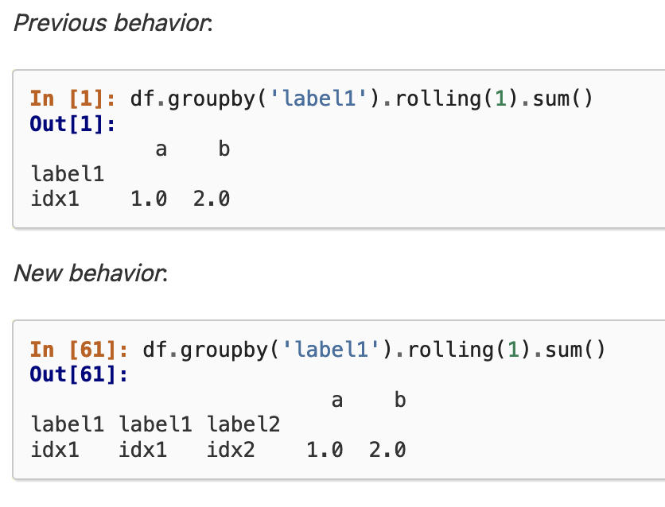
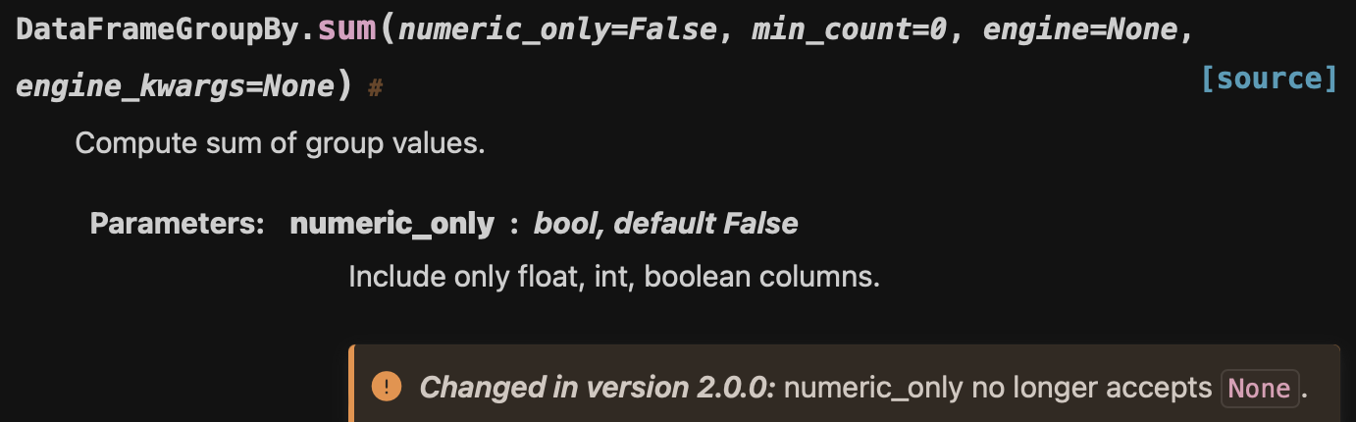
Why environments?
Avoid errors when working on multiple projects / updating your Python packages
—> if you keep updating your python packages, you will run into issues
code errors
unexpected results

Slide 4
Why environments?
Avoid importing errors when working on multiple projects / updating your Python packages
scipy=1.3
pandas=1.5.3
scipy=1.3
pandas=1.5.3
numpy=1.20.0
numpy=1.23.0

Slide 5
Virtual Environments
Create and activate a virtual environment following the directions in Exercise 5 Virtual Environments.md
Notes:
Where does it make sense to put the venv folder?

Slide 6
Notes

Slide 7
Environment Managers
venv - current standard recommended by Python
uv - super fast and super useful
etc
a description of the chaos: https://chriswarrick.com/blog/2023/01/15/how-to-improve-python-packaging/ https://alpopkes.com/posts/python/packaging_tools/

Slide 8
Why environments?
Avoid errors when working on multiple projects / updating your Python packages
Increased reproducibility: give yourself / other people the exact instructions and tools to run your code (cluster, collaboration)

Slide 9
Additional advantages
The main advantage is that you can start over if something goes wrong and you have broken nothing!

Slide 10
Our goal
Local importing
→ review and best practices
Packages and editable installations
→ avoid importing errors
Repo structure
→ organize folders and files in a standardized way
Accessibility
→ make code more readable, understandable and usable
Environments
avoid and alleviate package installation problems

Slide 11
readability

Slide 12
Why environments?
Project 1 = 1st year PhD project
tensorflow
numpy
Project 2 = collaboration with another lab
word2vec
seaborn
stats
pandas
pytorch
dependencies
Notes:
This is the part where we solve installation errors

Slide 13
Why environments?
pandas = 2.0.3
x
Project 1 = 1st year PhD project
Project 2 = 2nd year PhD project
pandas = 1.2.4
pandas = 1.2.4
dependencies

